Slide 1
Counting and recognizing non-moving objects by means of image processing
ESAT 1A1
Co-titular: Tinne Tuytelaars
Coaches: Xuanli Chen & José Oramas
Realised by: Max Beerten, Brent De Bleser, Wouter Devos,
Ben Fidlers, Simon Gulix, Tom Kerkhofs

Slide 2
Table of contents
Introduction
Problem description
Hardware
Software
Depth
Overlap
Colour
Application
Flaws
GUI
Conclusion

Slide 3
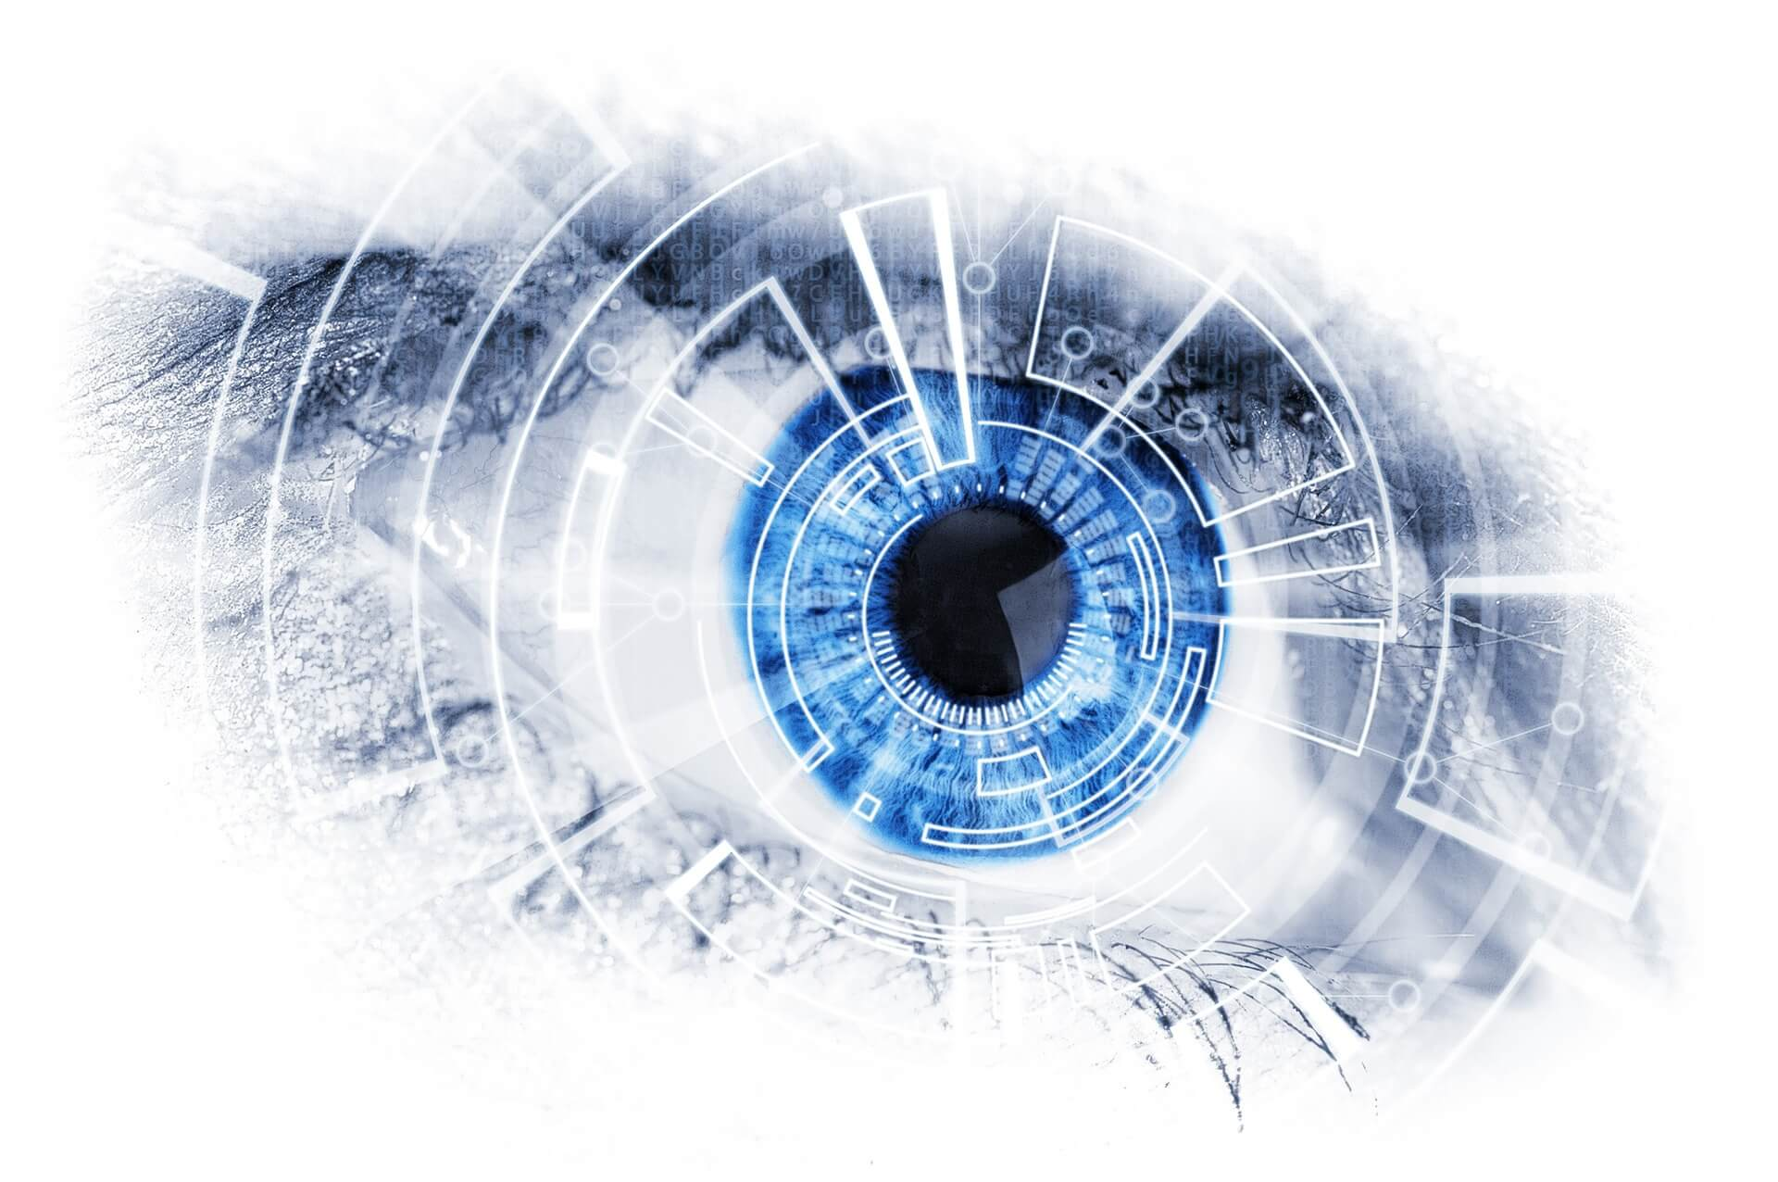
1. Introduction
Object counting using image processing
AI and machine learning
PSI at ESAT
Retrieved from DevisionX ¹
¹ Why you should integrate machine vision in your production process? (02/02/18). Retrieved (22/11/2018), from https://devisionx.com

Slide 4
Table of contents
Introduction
Problem description
Hardware
Software
Depth
Overlap
Colour
Application
Flaws
GUI
Conclusion

Slide 5
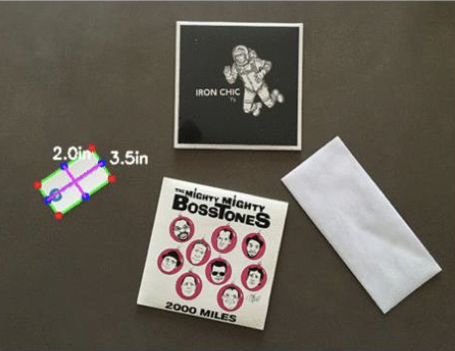
2. Problem description
Visual inspection system
Objects of uniform colour and shape
Camera
Retrieved from Toledo ²
² Opgaveblad P&0 3: Automatisch tellen van voorwerpen in een beeld

Slide 6
Table of contents
Introduction
Problem description
Hardware
Software
Depth
Overlap
Colour
Application
Flaws
GUI
Conclusion

Slide 7
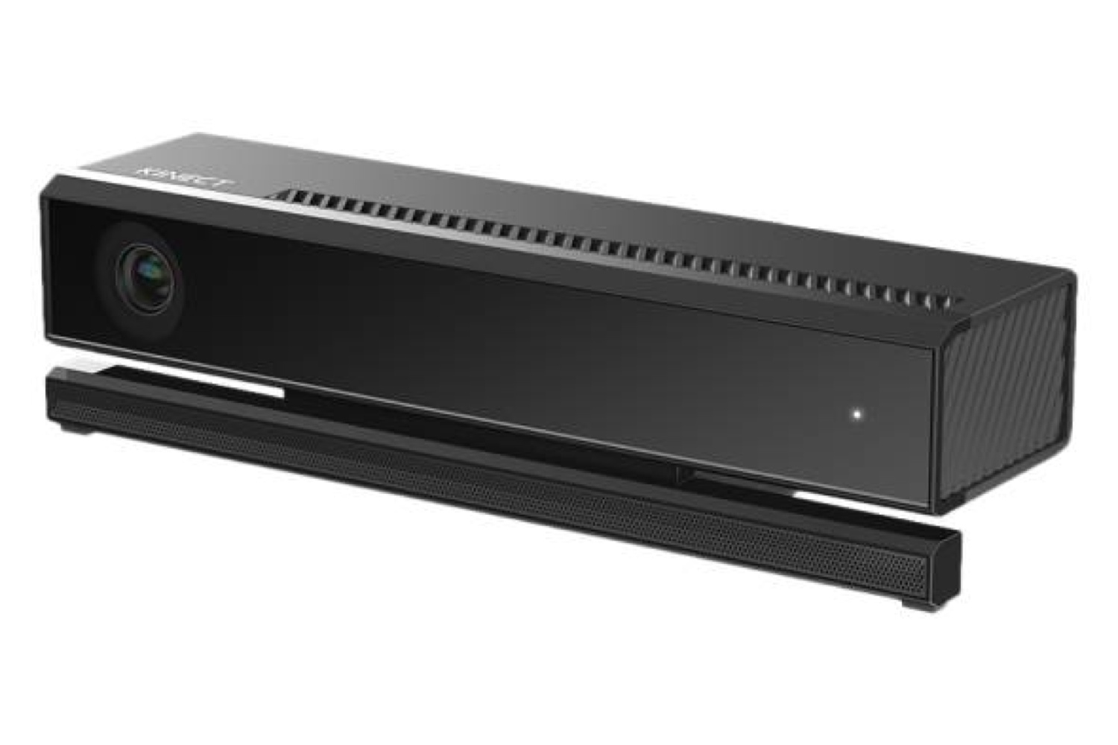
3. Hardware
Hardware components:
Camera
Transfer cable
PC
Box
Retrieved from Time ³
FOTO BOX
³ Why you should integrate machine vision in your production process? (07/07/14). Retrieved (14/12/2018), from http://time.com/2962269/kinect-v2-0-for-windows/

Slide 8
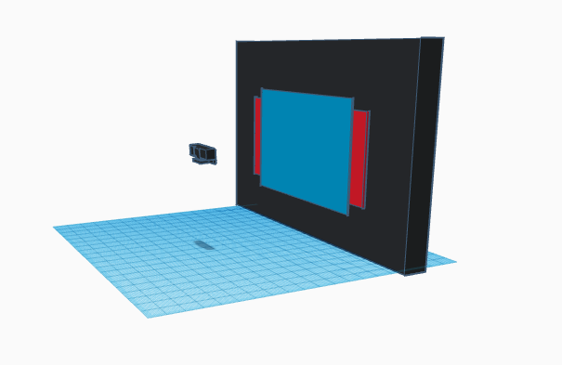
3. Hardware
Kinect v2
Colour and depth sensor
Different field of views
Matrix representation

Slide 9
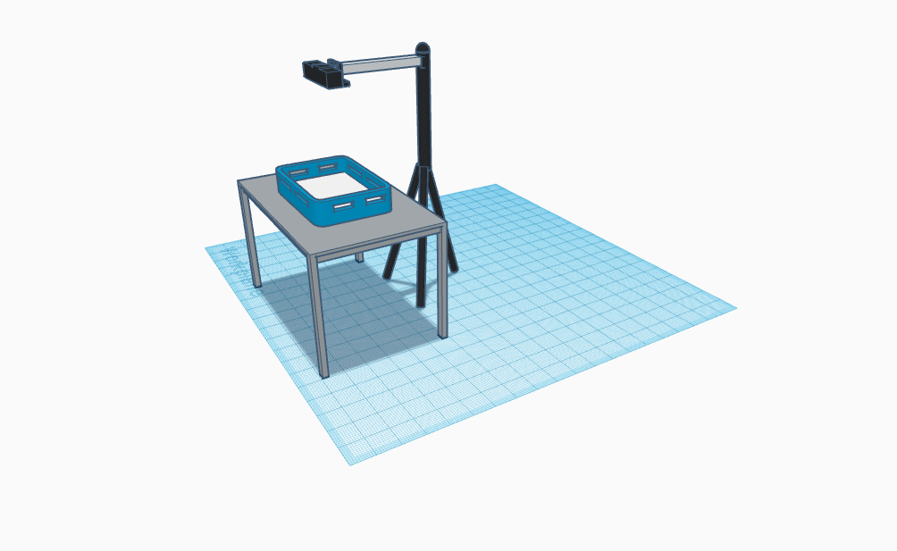
3. Hardware
Visual setup:
Height
Angle
Lighting

Slide 10
Table of contents
Introduction
Problem description
Hardware
Software
Depth
Overlap
Colour
Application
Flaws
GUI
Conclusion

Slide 11
4. Software

Slide 12
Table of contents
Introduction
Problem description
Hardware
Software
Depth
Overlap
Colour
Application
Flaws
GUI
Conclusion

Slide 13
4.a Depth

Slide 14
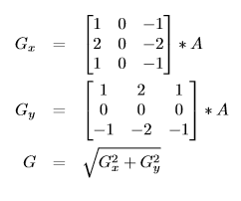
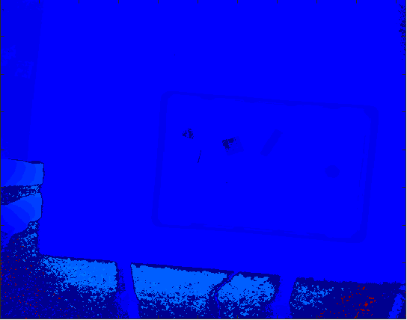
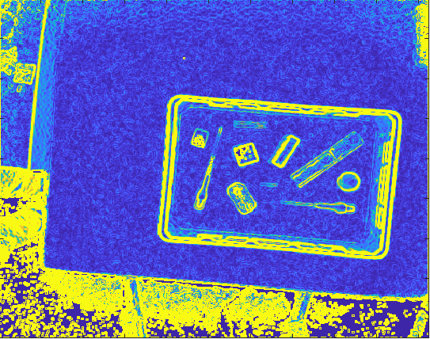
Step 1: Detection of the diﬀerence in height
Sobel-Feldman operator
≈ Gradient vector
Convolving kernel with depth matrix

Slide 15
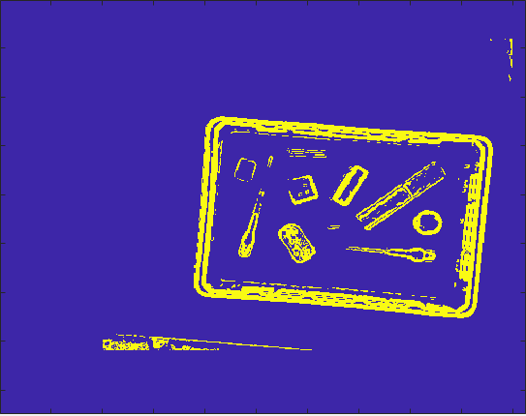
Step 2: Filtering of the noise
Delete noise + impossible elements
a < x < A; b < y < B; c < value < C
c = 30; C = 500
Result = binary matrix

Slide 16
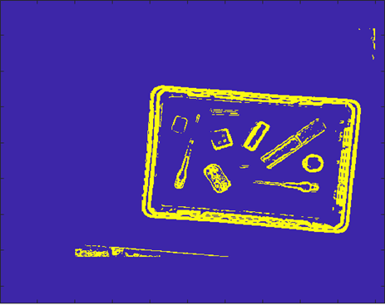
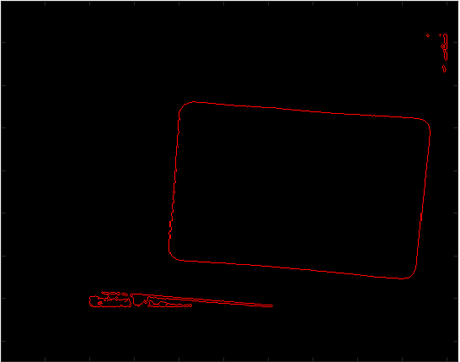
Step 3: Find the outer edge
Function runs from top left to bottom right
Value == 0?
No edge
Next position
Value == 1?
Edge
Surround object with ‘-1’
Value == -1?
Already surrounded
Skip to next -1

Slide 17
4a. Depth
Step 1: Detection of the difference in height
Sobel-Feldman operator
≈ Gradient vector
Convolving kernel with depth matrix

Slide 18
4a. Depth
Step 2: Filtering of the noise
Delete noise + impossible elements
a < x < A; b < y < B; c < value < C
c = 30; C = 500
Result = binary matrix

Slide 19
4a. Depth
Step 3: Find the outer edge
Function runs from top left to bottom right
Value == 0?
No edge
Next position
Value == 1?
Edge
Surround object with ‘-1’
Value == -1?
Already surrounded
Skip to next -1

Slide 20
Table of contents
Introduction
Problem description
Hardware
Software
Depth
Overlap
Colour
Application
Flaws
GUI
Conclusion

Slide 21
4.b Overlap

Slide 22
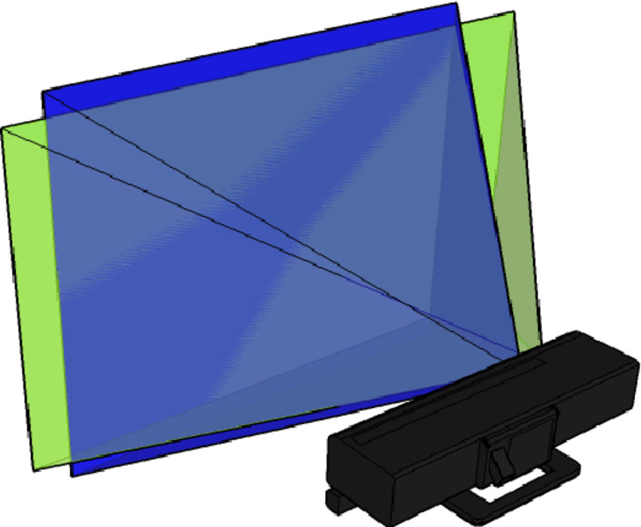
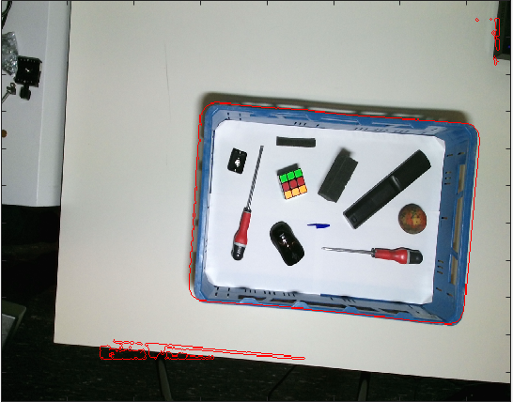
Step 1: Combine Depth and RGB
Crop height Depth and width RGB
Find proportion pixels (1x1 ≈ 3x3)
Map Depth to RGB
Retrieved from Researchgate ¹
¹ Calibration of Kinect for Xbox One and Comparison between the Two Generations of Microsoft Sensors, Diana Pagliari (01/10/2015), Retrieved 16/12/2018 from www.researchgate.net

Slide 23
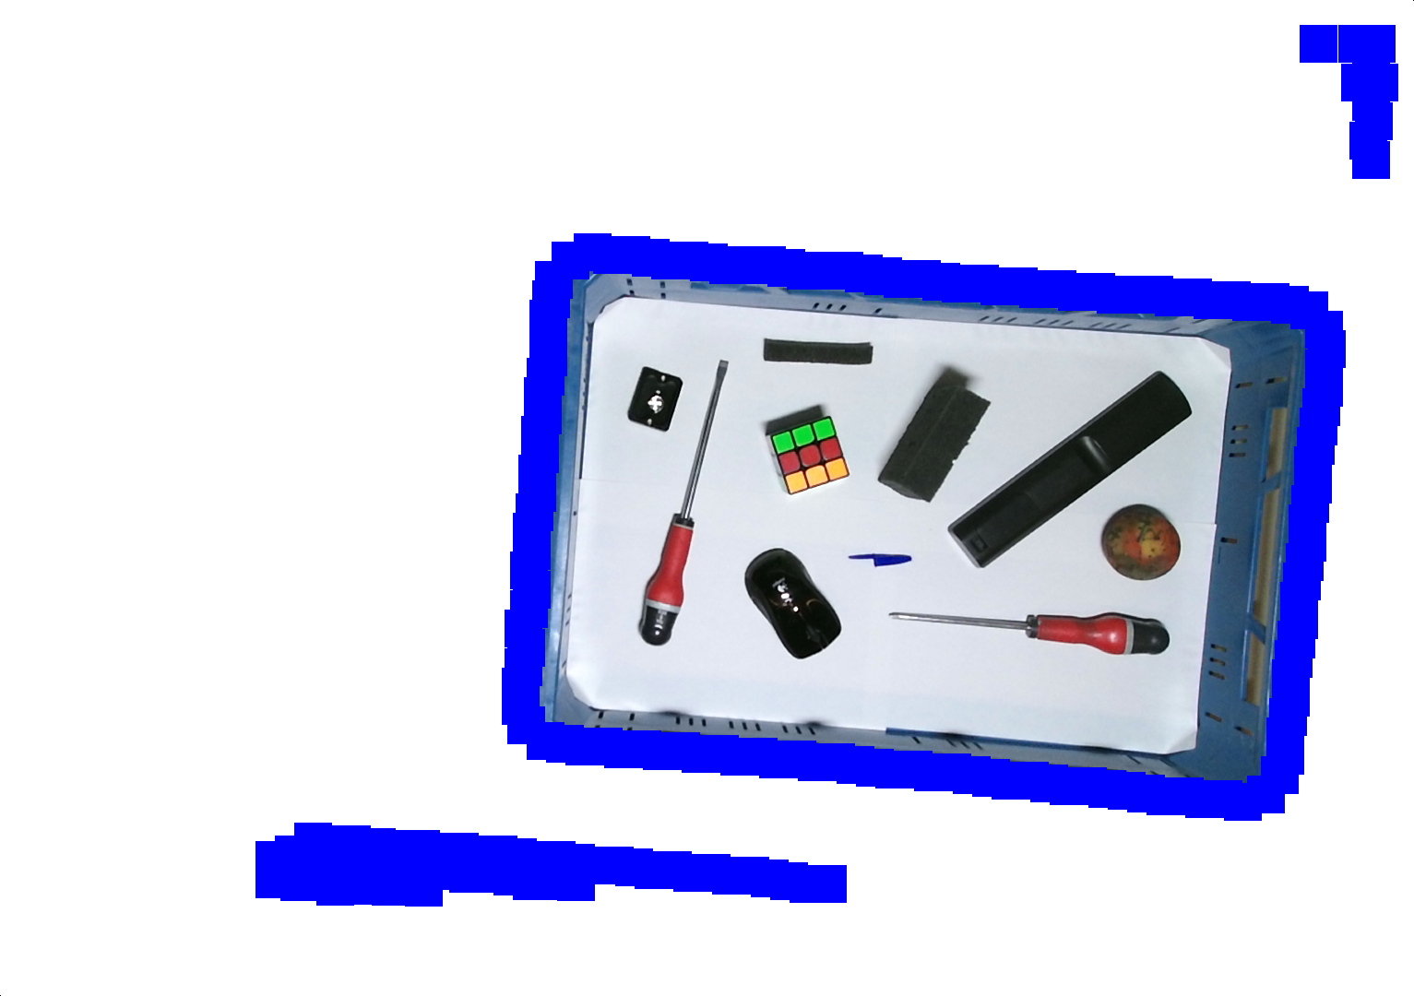
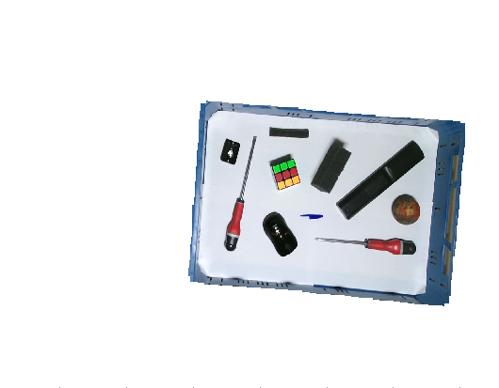
Step 2: Crop the matrix to the basket
Create thicker edge
Run through matrix in 4 directions
Value = (0;0;0) until value == (0;0;255)
Clears small imperfections

Slide 24
4b. Overlap
Step 1: Combine Depth and RGB
Crop height Depth and width RGB
Find proportion pixels (1x1 ≈ 3x3)
Map Depth to RGB
Retrieved from Researchgate ¹
¹ Calibration of Kinect for Xbox One and Comparison between the Two Generations of Microsoft Sensors, Diana Pagliari (01/10/2015), Retrieved 16/12/2018 from www.researchgate.net

Slide 25
4b. Overlap
Step 2: Crop the matrix to the basket
Create thicker edge
Run through matrix in 4 directions
Value = (0;0;0) until value == (0;0;255)
Clears small imperfections

Slide 26
Table of contents
Introduction
Problem description
Hardware
Software
Depth
Overlap
Colour
Application
Flaws
GUI
Conclusion

Slide 27
4.c Colour

Slide 28
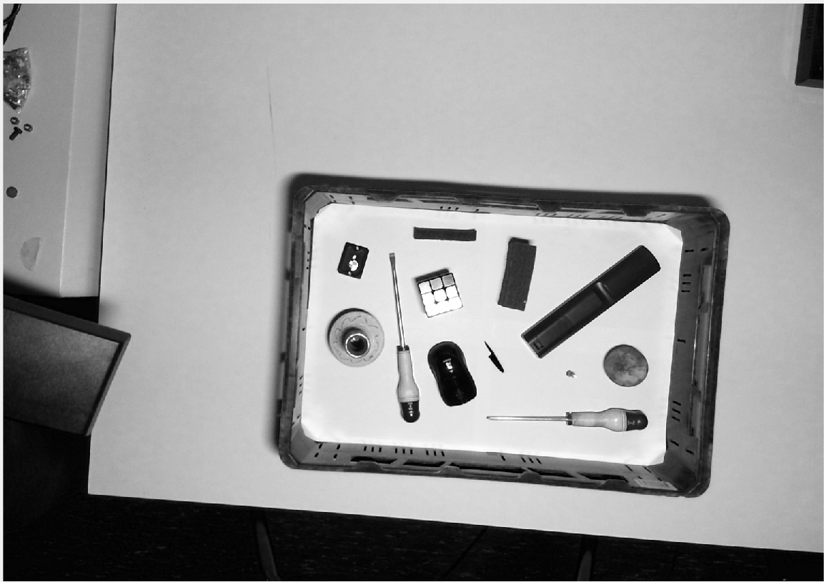
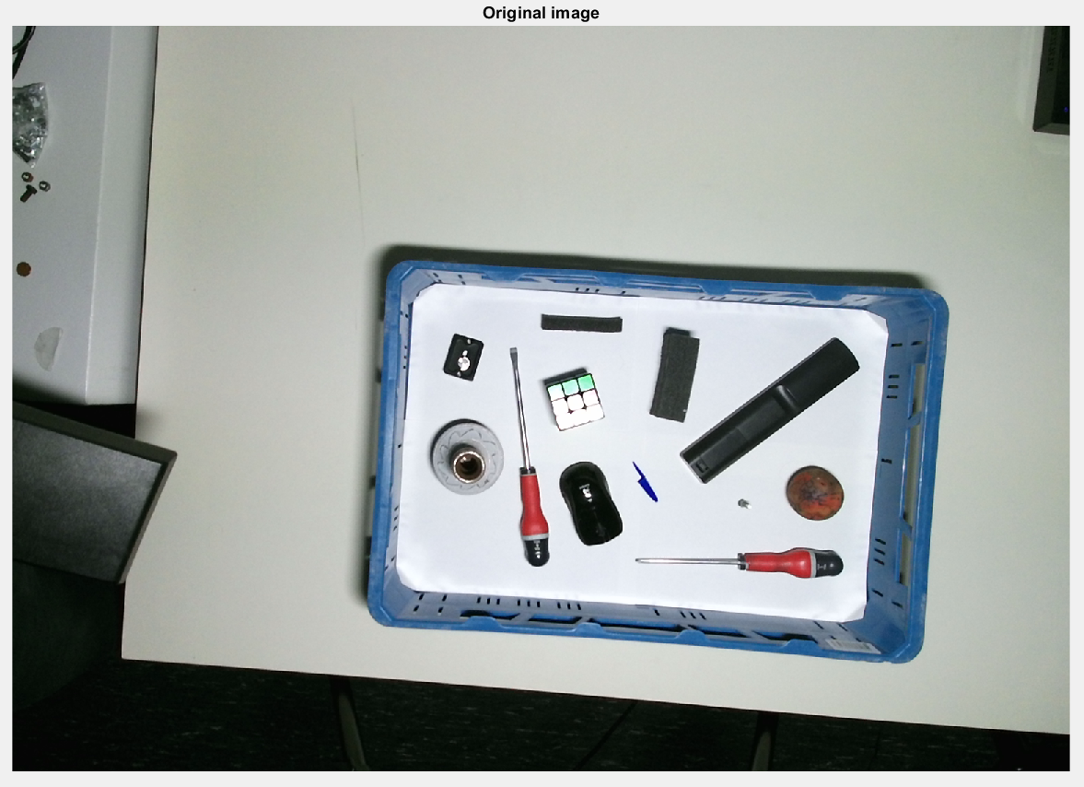
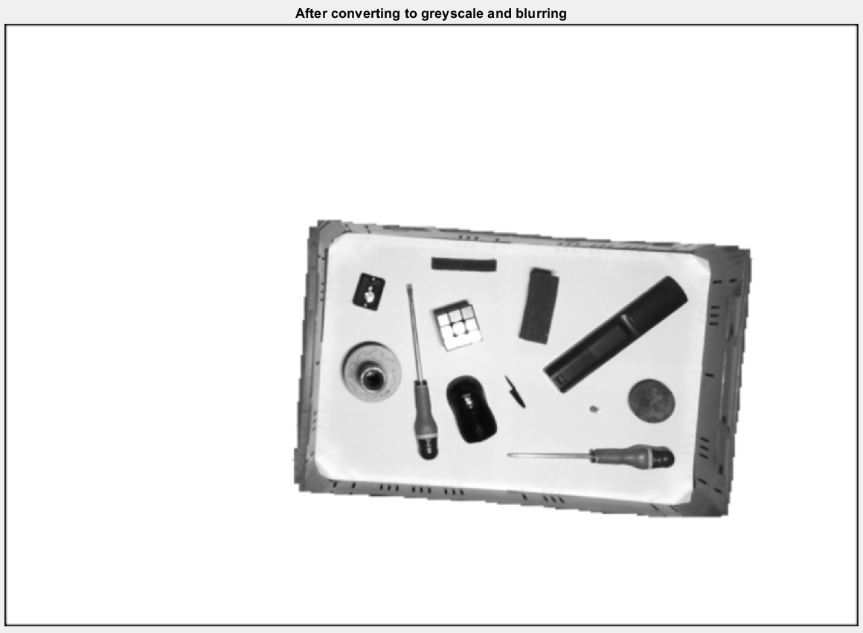
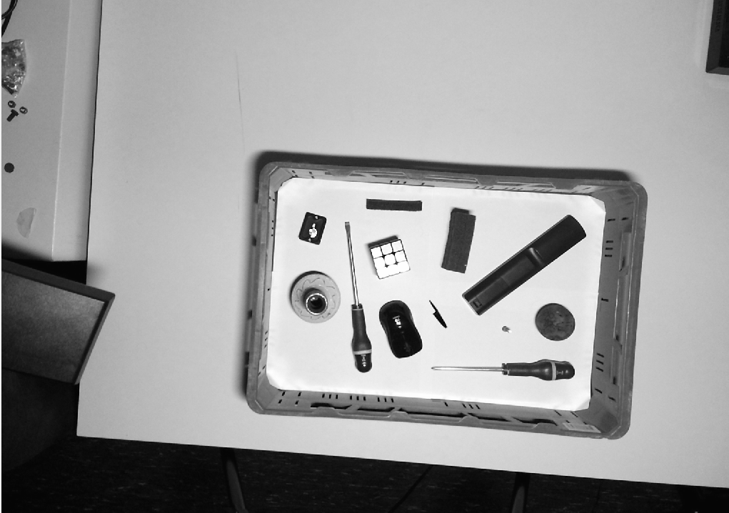
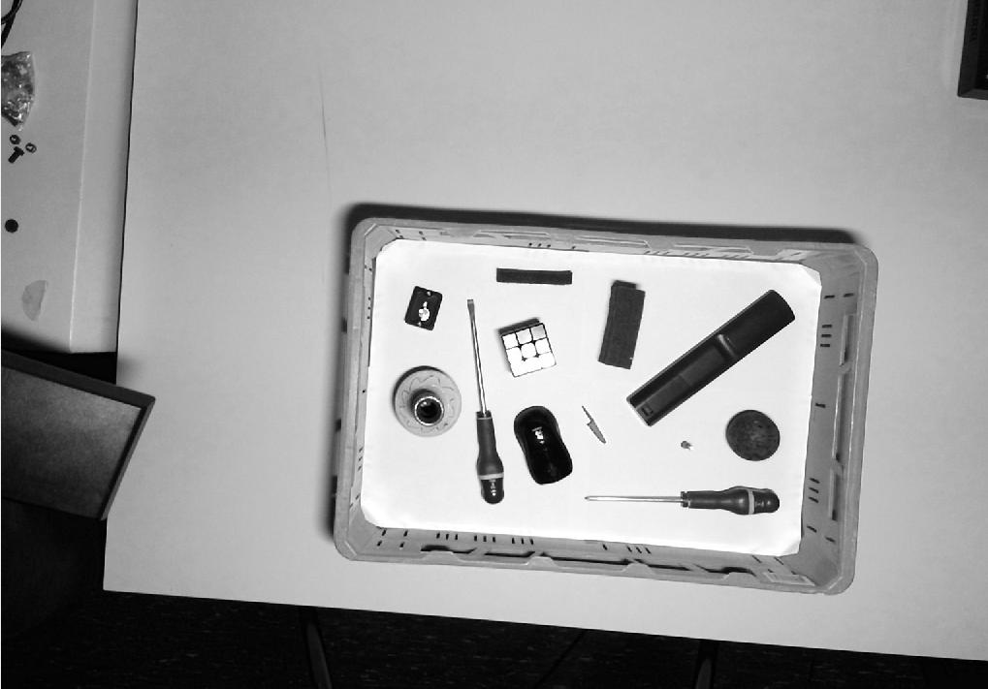
Step 1: Converting to greyscale
Red
0.2989
Green
0.5870
0.1140
Blue

Slide 29
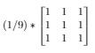
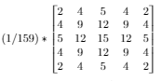
Step 2: Blurring
First a mean blur, than a gaussian blur.
Mean kernel
Gaussian kernel
*
*

Slide 30
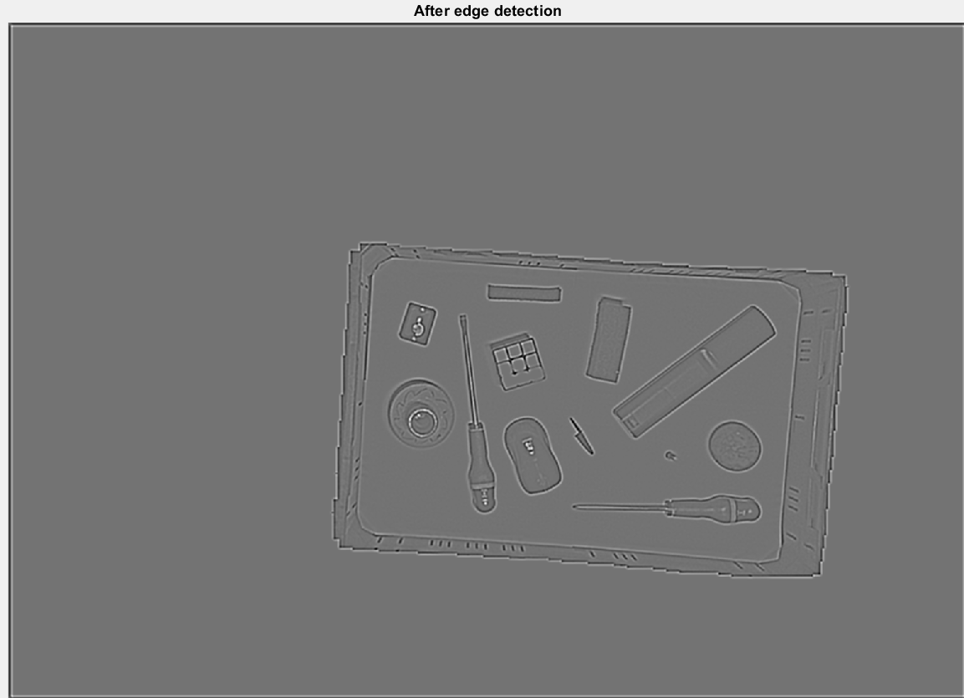
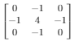
Step 3: Edge detection
*
=

Slide 31
Problem with convolutions
1
1
1
1
1
1
1
1
1
1 1
1 1 1 1 1 1 1 1 1 1 1 1
Remove_boundary()

Slide 32
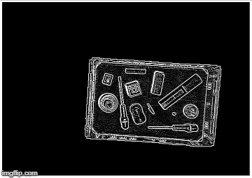
Step 4: Thresholding edge
Notice the white border

Slide 33

Step 5: Grouping

Slide 34
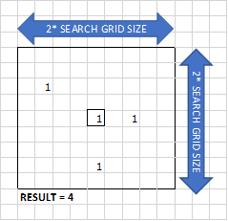
Loop through every pixel:
Check if pixel is black
Count same pixels values in grid
Check if that amount of pixels is big enough
Search for group number in grid (No group found? -> assign new group number)
Place group number in matrix

Slide 35
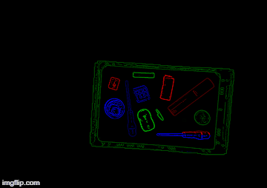
Step 6: Regrouping
Loop through every pixel (right-top to left-bottom)
Check if group number is not 0.
Check if there is another group in the X-pixels below this pixel.
Replace group number of the bottom group with the top group number.

Slide 36
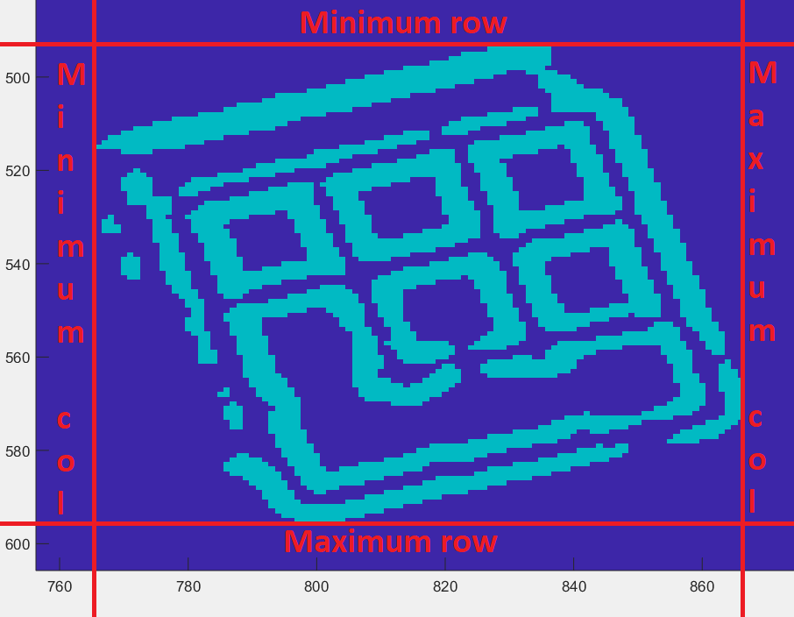
Step 7: Drawing boundary boxes

Slide 37
Table of contents
Introduction
Problem description
Hardware
Software
Depth
Overlap
Colour
Application
Flaws
GUI
Conclusion

Slide 38
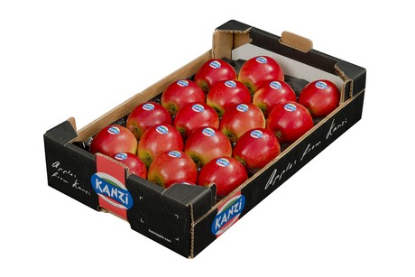
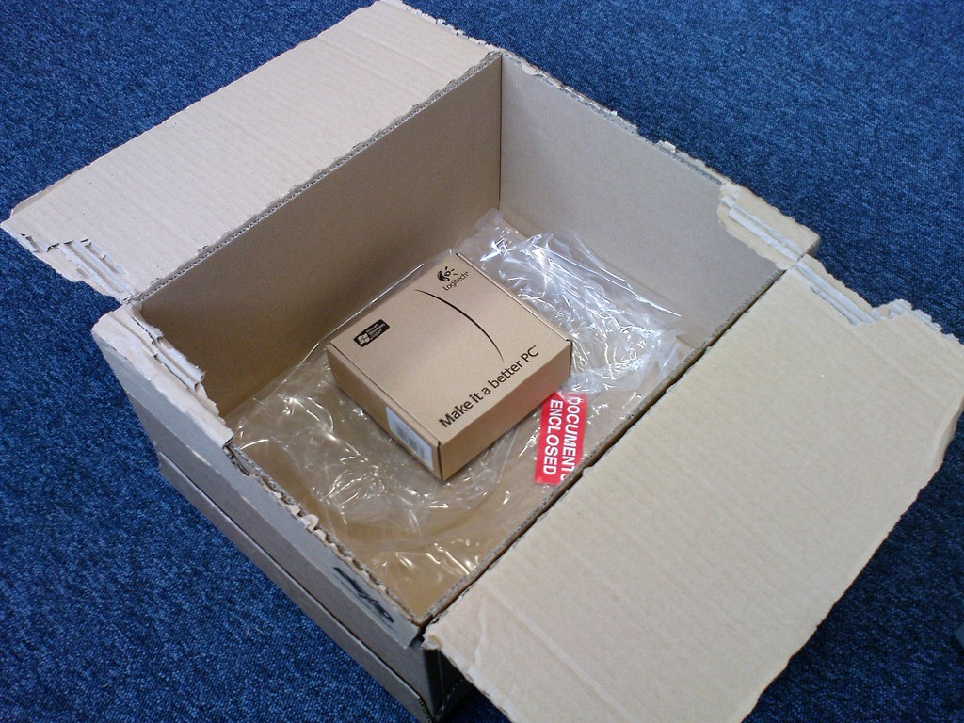
5. Application
General:
Engineering project
Counting uniform objects
Optimal object packaging
Retrieved from Freshplaza ⁴
Solving the Box Selection Algorithm
Retrieved from Medium ⁵
⁴ Preis für Kanzi erzielt Rekordhöhe (06/03/18). Retrieved (15/12/2018), from https://www.freshplaza.de/artikel/5015819/preis-fuer-kanzi-erzielt-rekordhoehe/
⁵ Solving the Box Selection Algorithm (01/07/16). Retrieved (14/12/2018), from https://medium.com/the-chain/solving-the-box-selection-algorithm-8695df087a4

Slide 39
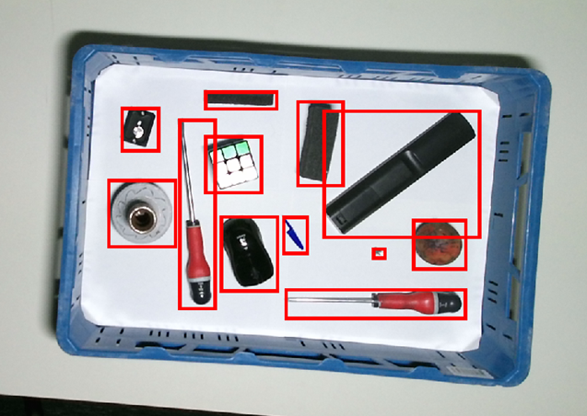
5. Application
Approach
Starting where we left off
Cut objects out of image
Sort them from large to big
Fill the given basket as efficient as possible

Slide 40
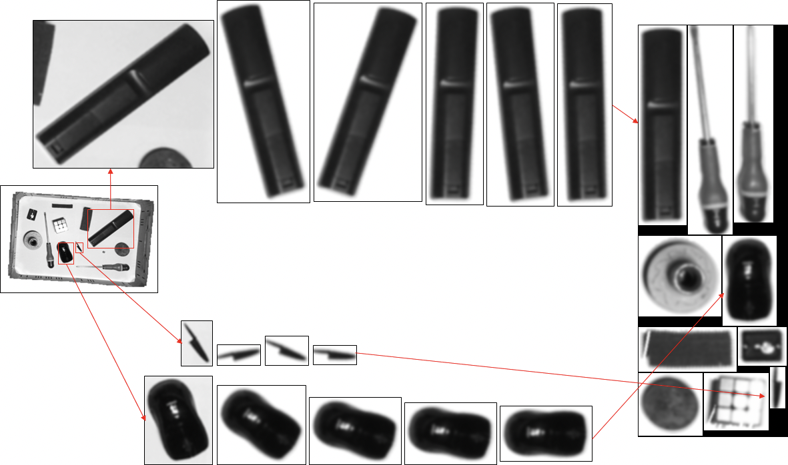
5. Application
Step 1:
Gathering all objects
Non-optimal packaging
Elements get whitened (in deze stap al??)

Slide 41
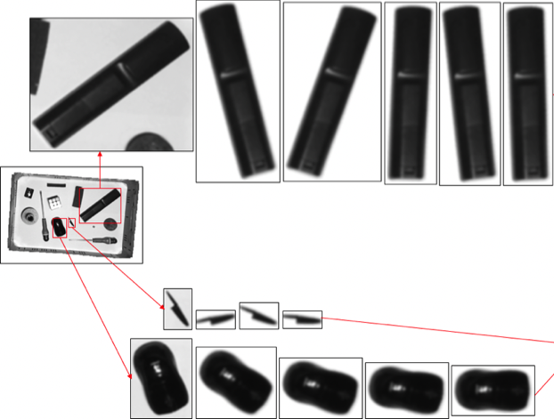
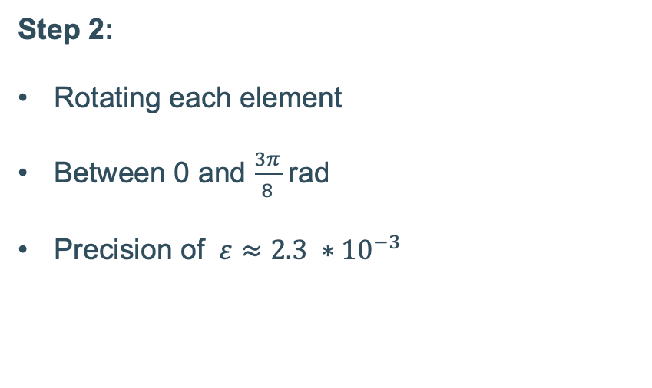
5. Application
Step 2:
Rotating each element
Between 0 and $\frac{3π}{8}$ rad
Precision of $ε≈2.3 ∗{10}^{−3}$

Slide 42
5. Application
Step 3:
Combining all optimal boundary boxes
Greedy algorithm
Normal matrix and its transpose

Slide 43
Table of contents
Introduction
Problem description
Hardware
Software
Depth
Overlap
Colour
Application
Flaws
GUI
Conclusion

Slide 44
6. Flaws

Slide 45
Table of contents
Introduction
Problem description
Hardware
Software
Depth
Overlap
Colour
Application
Flaws
GUI
Conclusion

Slide 46
7. GUI

Slide 47
Table of contents
Introduction
Problem description
Hardware
Software
Depth
Overlap
Colour
Application
Flaws
GUI
Conclusion

Slide 48
8. Conclusion
Depth data
Finding basket
Overlap
Depth and RGB
RGB Image of basket
Finding best package
Boundary boxes
Grouping edges
Finding edges

